Slide 1
Image and Video Processing

Slide 2
5.1 Lossless Coding--Introduction
What’s lossless coding?
represent an image signal with the smallest possible number of bits without loss of any information
speed up transmission and minimizing storage requirements
Example: a single uncompressed video frame with a resolution of 500 x 500 pixels would require 100 s over a capacity of 64,000 bit/s(64 Kbps). The resulting delay is intolerably large, considering that a delay as small as 1-2 s is needed to conduct an interactive “slide show,” and a much smaller delay (of the order of 0.1 s) is required for video transmission or playback.

Slide 3
5.1 Lossless Coding--Introduction
Why is lossless coding possible?
Redundancy—correlation among the image
Spatial correlation among neighbor pixels
Temporal correlation among video frames
Spectral correlation between image samples
Notes:
视频数据中存在着大量的冗余， 即图像的各像素数
据之间存在极强的相关性。 利用这些相关性， 一部
分像素的数据可以由另一部分像素的数据推导出来，
结果视频数据量能极大地压缩，有利于传输和存储。
视频数据主要存在以下形式的冗余:
视频图像在水平方向相邻像素之间、垂直方向相邻像素之间的变化一般都很小， 存在着极强的空间相关性。 特别是同一景物各点的灰度和颜色之间往往存在着空间连贯性，从而产生了空间冗余， 常称为帧内相关性。
在相邻场或相邻帧的对应像素之间， 亮度和色度信息存在着极强的相关性。 当前帧图像往往具有与前、后两帧图像相同的背景和移动物体， 只不过移动物体所在的空间位置略有不同，对大多数像素来说， 亮度和色度信息是基本相同的，称为帧间相关性或时间相关性。

Slide 4
5.1 Lossless Coding--Introduction
Applications of lossless coding
Compression of digital media imagery
Facsimile transmission of bitonal images
Several Standards for lossless compression
Lossless JPEG standard
Facsimile compression standards
JBIG compression standard

Slide 5
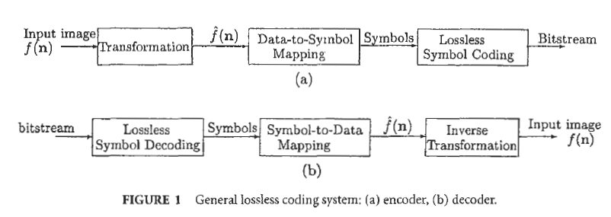
5.1 Lossless Coding—Basic ideas

Slide 6
5.1 Lossless Coding—Basic ideas
Transformation
Apply a reversible (one-to-one) transformation
reduce data correlation, alter the data distribution, pack a large amount of information into few data samples or subband regions
Include differential or predictive mapping, unitary transforms, subband decompositions….

Slide 7

5.1 Lossless Coding—Basic ideas
Data-to-Symbol Mapping
convert transformed image into symbols
partitioning
Running-length coding (RLC)

Slide 8
5.1 Lossless Coding—Basic ideas
Lossless Symbol Coding
assign binary codewords to the input symbols
variable-length coding (VLC) i.e., entropy coding, such as Huffman and arithmetic coding
fixed-length coding, such as dictionary (Lempel-Ziv) coding

Slide 9
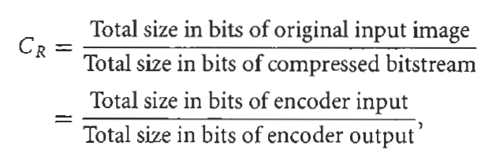
5.1 Lossless Coding—Basic ideas
Factors of Lossless Symbol Coding
Compression efficiency----compression ratio

Slide 10
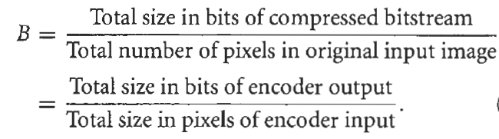
5.1 Lossless Coding—Basic ideas
Factors of Lossless Symbol Coding
Compression efficiency------average bit rate in bits per pixel

Slide 11
5.1 Lossless Coding—Basic ideas
Factors of Lossless Symbol Coding
Coding delay—minimum time required to both encode and decode an input data sample
Implementation complexity—required number of arithmetic operations per second and the memory requirement
Robustness—robustness of the coding method to transmission errors

Slide 12
5.1 Lossless Coding—Lossless symbol coding
Statistical schemes (Huffman, Arithmetic)
require the source symbol probability distribution;
shorter codewords for the symbols with higher probability of occurrence

Slide 13
5.1 Lossless Coding—Lossless symbol coding
Dictionary-based schemes (Lempel-Ziv)
do not require a priori knowledge of the source symbol probability distribution;
dynamically construct encoding and decoding tables;
Fixed length binary codewords

Slide 14




5.1 Lossless Coding—Lossless symbol coding
Basic Concepts from Information Theory
source alphabet
self-information
first-order entropy (marginal entropy)
average bit rate

Slide 15
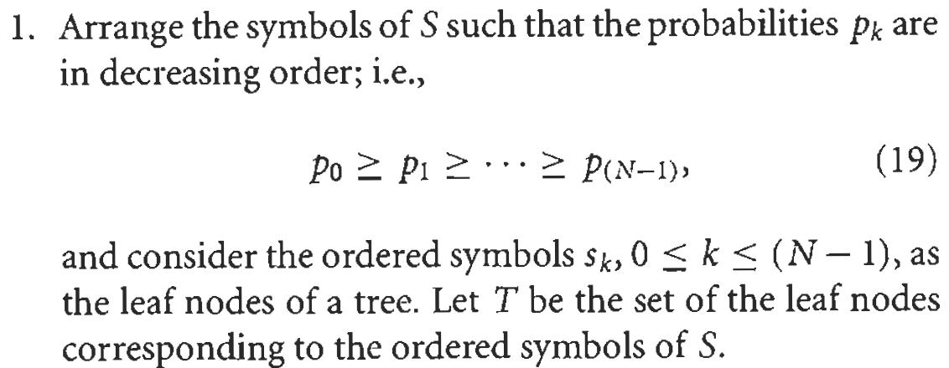
5.1 Lossless Coding—Lossless symbol coding
Huffman Coding

Slide 16
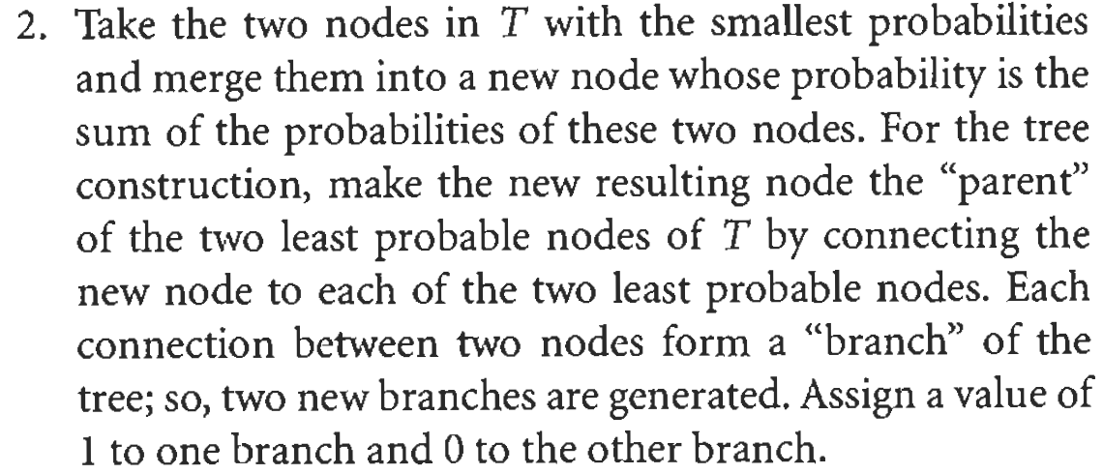
5.1 Lossless Coding—Lossless symbol coding
Huffman Coding

Slide 17
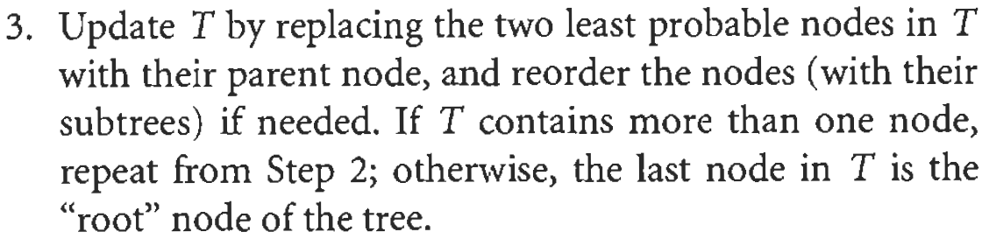
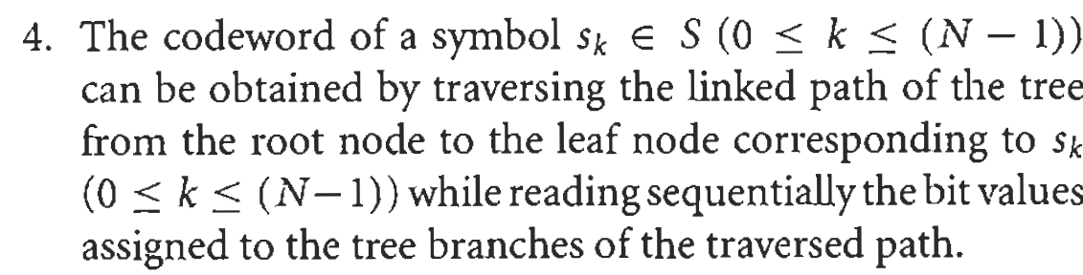
5.1 Lossless Coding—Lossless symbol coding
Huffman Coding

Slide 18
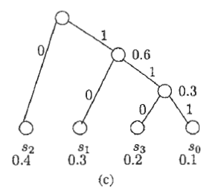
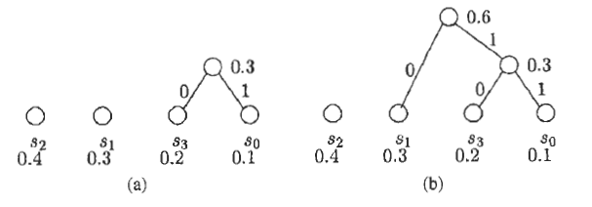
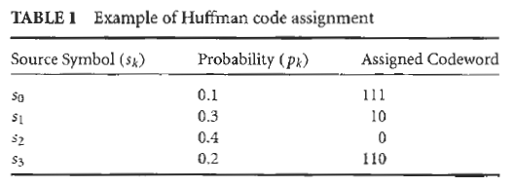
5.1 Lossless Coding—Lossless symbol coding
Huffman Coding

Slide 19
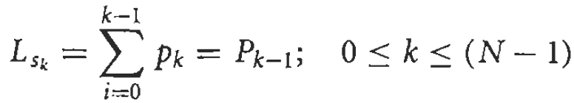
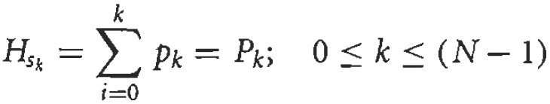
5.1 Lossless Coding—Lossless symbol coding
Arithmetic Coding

Slide 20
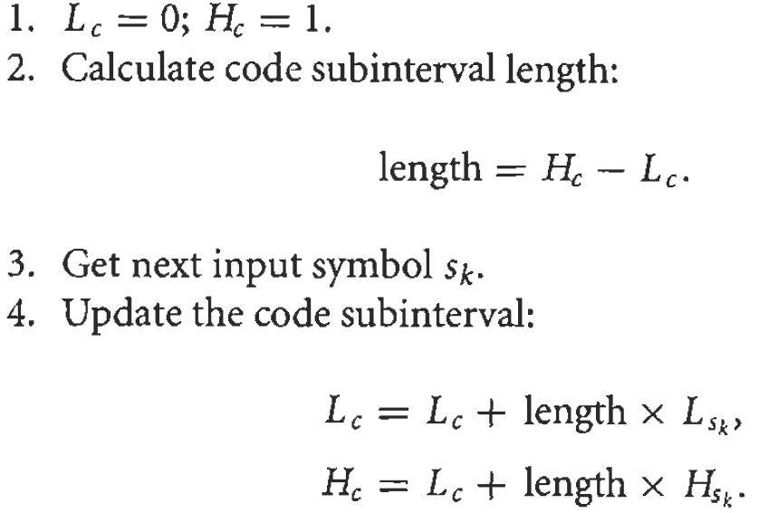
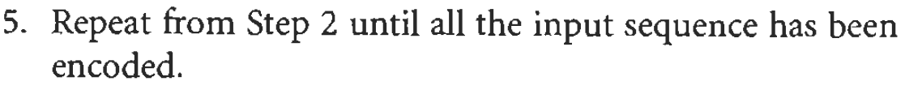
5.1 Lossless Coding—Lossless symbol coding
Arithmetic Coding

Slide 21
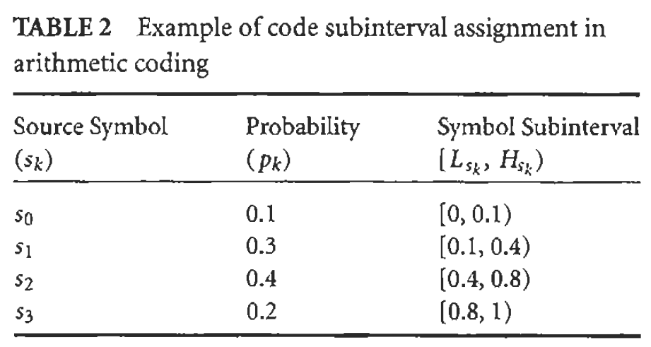
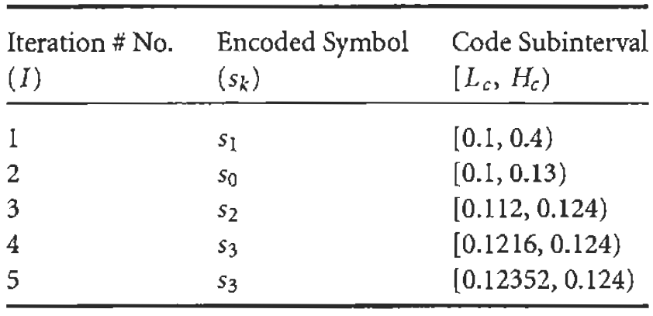
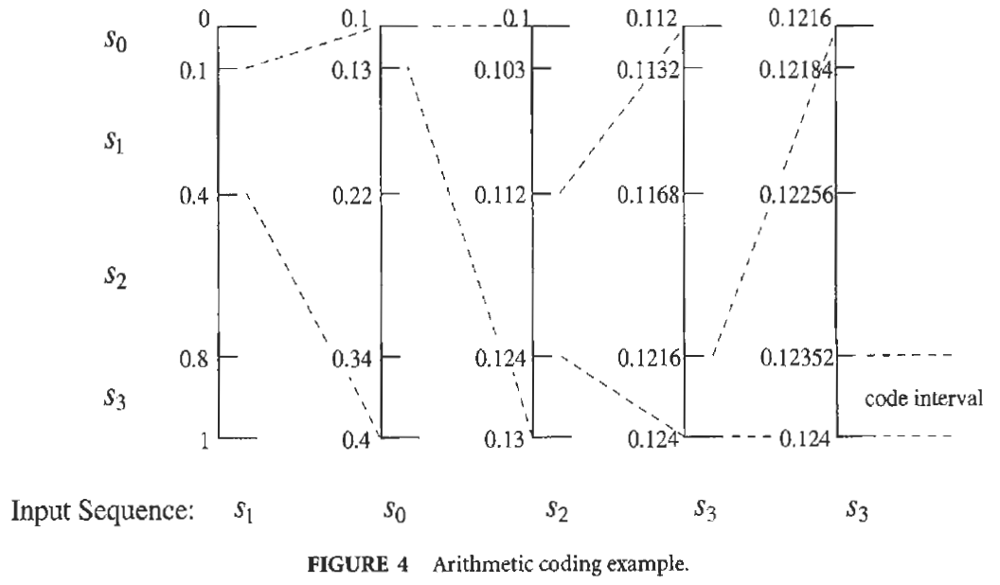
Arithmetic Coding

Slide 22
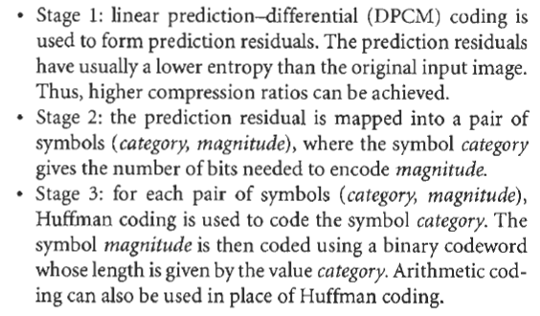
5.1 Lossless Coding –Lossless Coding Standards
JBIG (Joint Binary Image Experts Group) Standard
Lossless JPEG ((Joint Photographic Experts Group )Standard

Slide 23
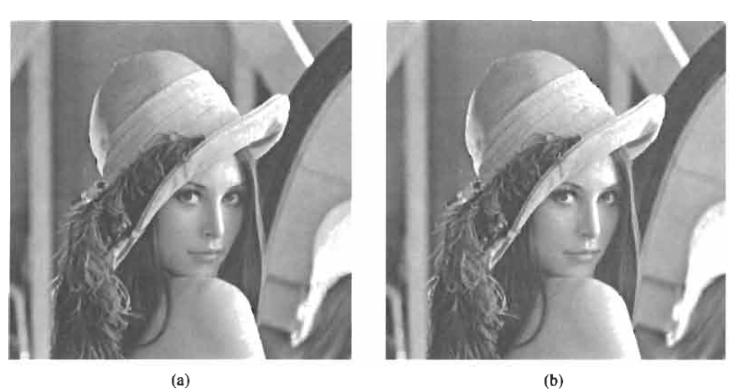
5.1 Lossless Coding–Other Developments
CALIC (Context-based, adaptive, lossless image codec)
Perceptually Lossless Image Coding

Slide 24
5.2 Block Truncation Coding-Introduction
Statistical and structural methods have been developed for image compression
Statistical method--the algebraic structure
of the pixels in an image
Structural method--the geometric structure of the image
Notes:
http://zh.wikipedia.org/wiki/%E6%96%B9%E5%9D%97%E7%BC%96%E7%A0%81
块截断编码

Slide 25
5.2 Block Truncation Coding-Basics
a lossy fixed length compression method that uses a Q-level quantizer to quantize a local region of the image
to preserve the sample mean and sample standard deviation of a gray-scale image in its simplest form
additional constraints can be added to preserve higher-order moments.
BTC is a block adaptive moment preserving quantizer

Slide 26
5.2 Block Truncation Coding-Algorithm
divide the image into nonoverlapping rectangular regions
let the sample mean of the block be the threshold; a “1” would then indicate if an original pixel value is above this threshold, and “0” if it is below.

Slide 27
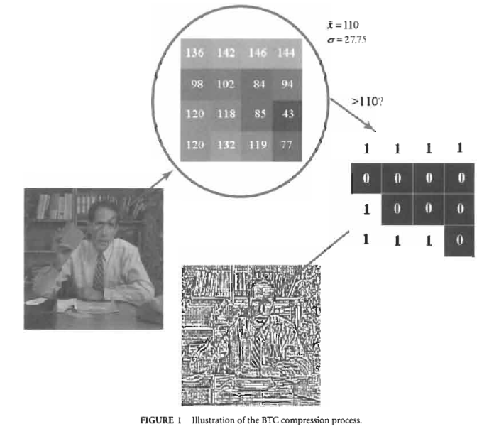
5.2 Block Truncation Coding-Algorithm

Slide 28
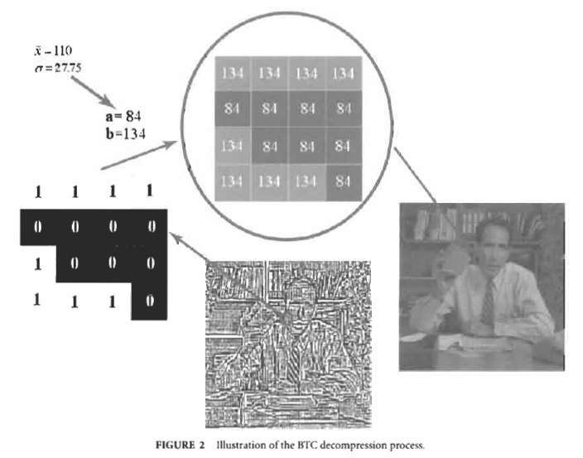
5.2 Block Truncation Coding-Decompression

Slide 29
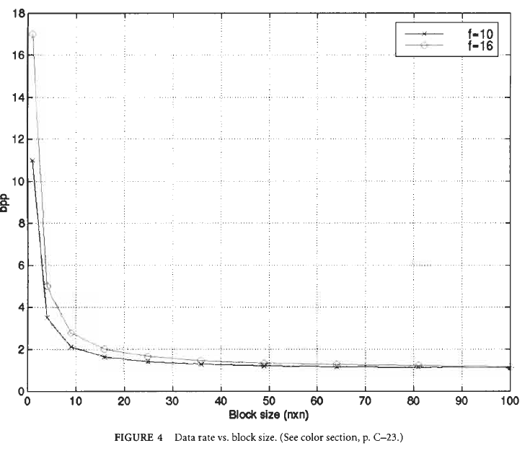
5.2 Block Truncation Coding-Algorithm
The data rate is then determined by the block size k and the number of bits f that are allocated to the sample mean and sample standard deviation of a block.

Slide 30
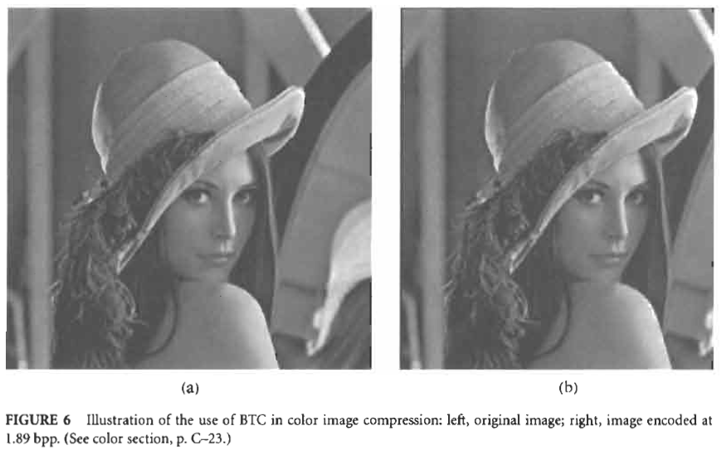
5.2 Block Truncation Coding-Variations and Applications of BTC
Variations
graphics images
predictive coding
coding color images
the use of absolute moments
video compression
……

Slide 31
5.2 Block Truncation Coding-Variations and Applications of BTC
Applications
HDTV
Sun’s CellB video format
XMovie
……

Slide 32
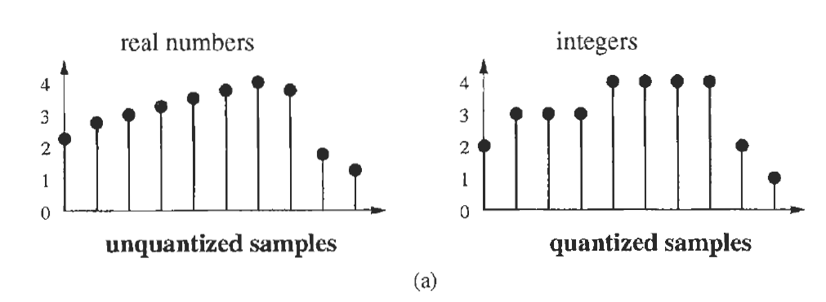

5.3 Vector Quantization--Introduction
Quantization is a mapping of a large set of values to a smaller set of values.

Slide 33
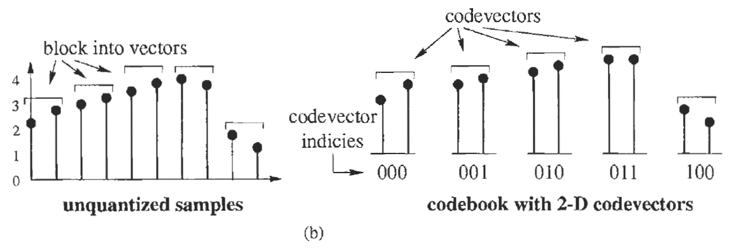

5.3 Vector Quantization--Introduction

Slide 34
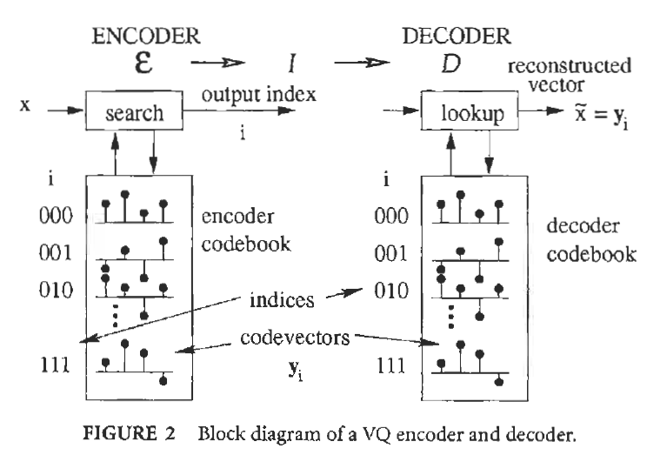
5.3 Vector Quantization--Introduction

Slide 35


5.3 Vector Quantization—Theory of Vector Quantization
The bit rate R associated with the VQ depends on N (the number of codevectors in the codebook) and the vector dimension k.
For quantifying the "quality of match" between two vectors x and y, the most common of which is the squared error given by

Slide 36

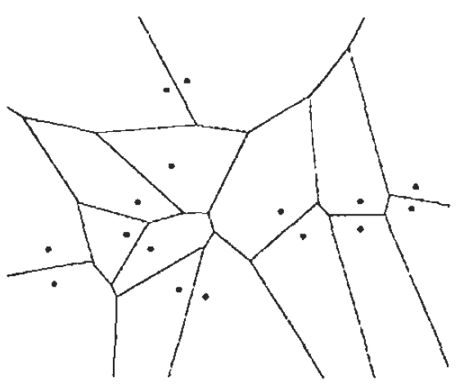
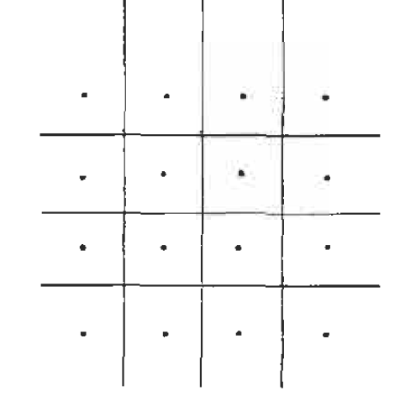

5.3 Vector Quantization—Theory of Vector Quantization

Slide 37
5.3 Vector Quantization—Design of Vector Quantizers
LBG Design Algorithm
Initialization (random selection)
Encoding of the training vectors
Computing of the centroids
Other Algorithms
Finding a good initial set of codevectors
Splitting algorithm
Neural nets
......

Slide 38
5.3 Vector Quantization—Structured VQ
Sacrifice performance for speed
Impose structural constraints on the VQ codebook
Linearly or quadratically dependent on the rate and dimension

Slide 39
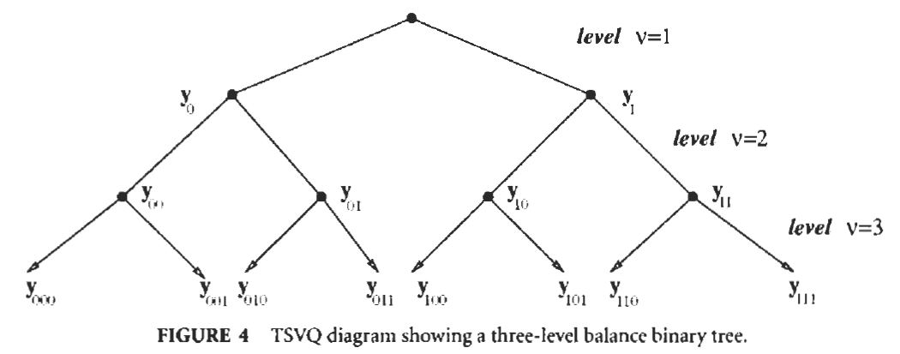
5.3 Vector Quantization—Structured VQ
Tree-Structured VQ
A hierarchical arrangement of codevectors
Searching efficiently

Slide 40
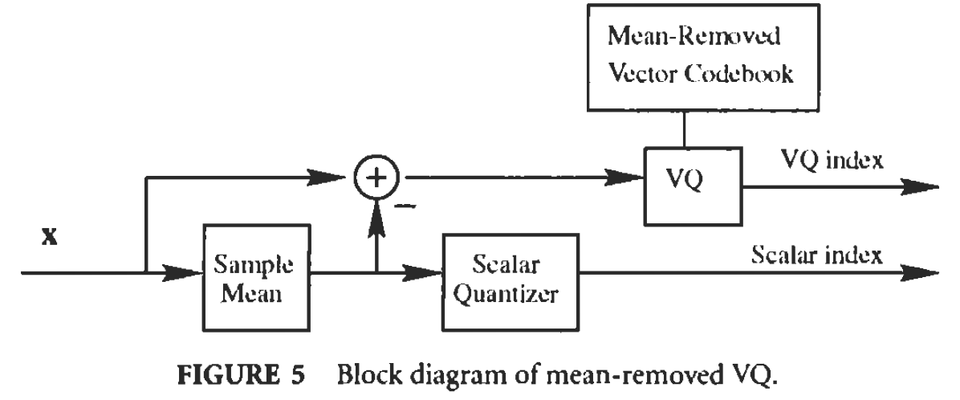
5.3 Vector Quantization—Structured VQ
Mean-Removed VQ
a codebook may have many similar vectors differing only in their mean
extract the variation among vectors and code that extracted component separately as a scalar

Slide 41
5.3 Vector Quantization—Structured VQ
Gain-Shape VQ
Multistage VQ
……

Slide 42
5.5 JPEG Lossy Image Compression Standard-Introduction
Part of the multipart set of ISO standards IS 10918-1,2,3 (ITU-T Recommendations T.81,T.83,T.84)
Entails an irreversible mapping of the image to a compressed bit stream with mechanisms for a controlled loss of information
produces a bit stream that is usually much smaller in size than that produced with lossless compression

Slide 43
5.5 JPEG Lossy Image Compression Standard-Introduction
Key features of the lossy JPEG standard:
Both sequential and progressive modes of
encoding are permitted.
Low complexity implementations in both hardware and software are feasible.
All types of images are permitted.
A graceful tradeoff in bit rate and quality is offered.
…….

Slide 44
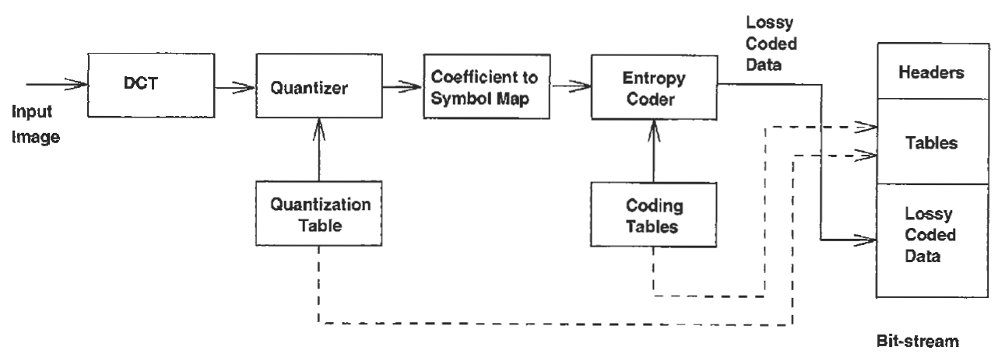
5.5 JPEG Lossy Image Compression Standard-Encoder Structure

Slide 45
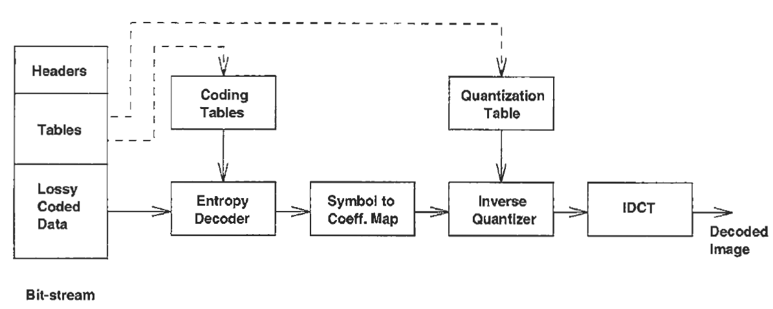
5.5 JPEG Lossy Image Compression Standard-Decoder Structure

Slide 46
5.5 JPEG Lossy Image Compression Standard-Discrete Cosine Transform
Lossy JPEG compression is based on transform coding that uses the DCT.
In DCT coding, each component of the image is subdivided into blocks of 8 x 8 pixels.
A two-dimensional DCT is applied to each block of data to obtain an 8 x 8 array of coefficients.

Slide 47
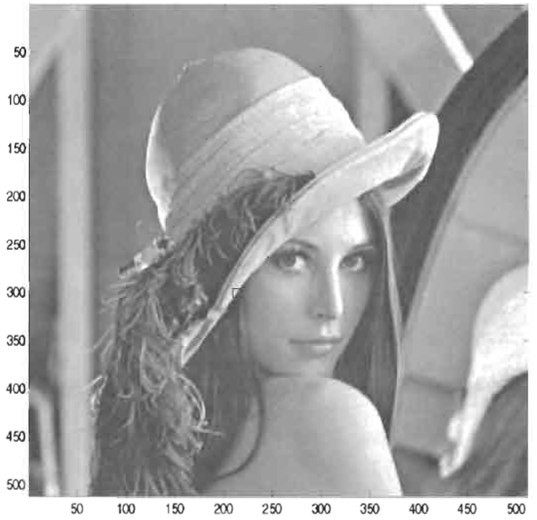
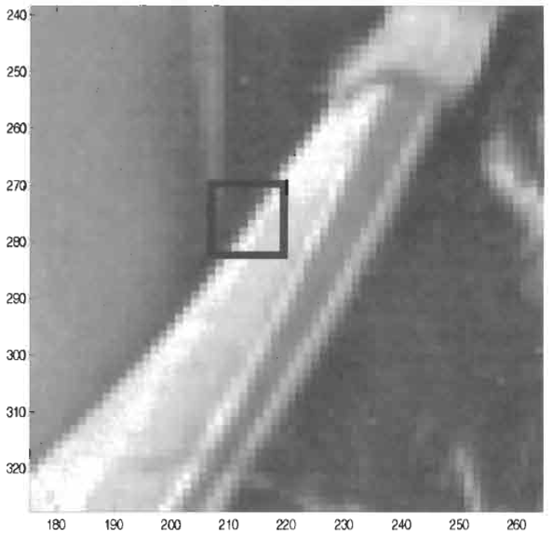
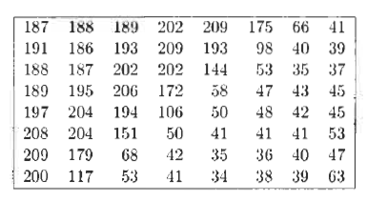
5.5 JPEG Lossy Image Compression Standard-Discrete Cosine Transform

Slide 48
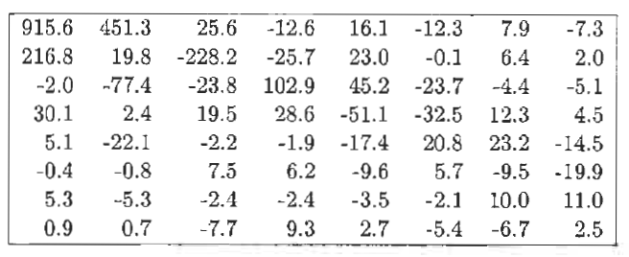

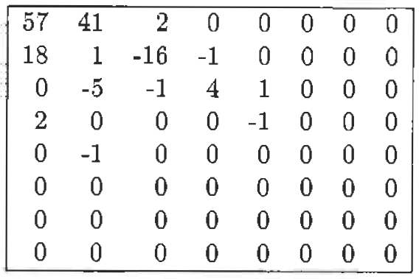
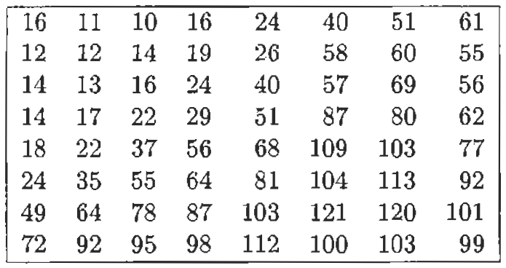
5.5 JPEG Lossy Image Compression Standard-Quantization

Slide 49
5.5 JPEG Lossy Image Compression Standard-Coefficient-to-Symbol Mapping and Coding
JPEG treats the DC coefficient and the set of AC coefficients differently.
JPEG uses the Huffman coding or arithmetic coding to represent the symbols.

Slide 50
5.5 JPEG Lossy Image Compression Standard-Coefficient-to-Symbol Mapping and Coding
DC Coefficient Symbols
Differential encoding
The difference is mapped to a symbol described by a pair (category, amplitude)

Slide 51
5.5 JPEG Lossy Image Compression Standard-Coefficient-to-Symbol Mapping and Coding
Mapping AC Coefficient to Symbols
Run-length coding
The symbols are defined as [runs, nonzero terminating value]

Slide 52
5.6 JPEG Lossless Image Compression Standards-Original JPEG Lossless Standards
Code the prediction error
Huffman Coding Procedures
Arithmetic Coding Procedures

Slide 53
5.6 JPEG Lossless Image Compression JPEG-LS
The difference between JPEG-LS and original lossless standards
JPEG-LS uses a nonlinear predictor
JPEG-LS uses context modeling of the prediction errors prior to encoding
JPEG-LS uses Golomb-Rice codes for encoding prediction errors
JPEG-LS uses a simple alphabet extension mechanism
JPEG-LS provides a near-lossless mode

